Slide 1
Evaluation and Results
Scores from different embedding
Inference
Sentence embedding has slightly higher performance parameters compared to GloVe(Word) embedding
However, the word embedding is not very effective to evaluate the insincere questions
Overall, the models are very effective in determining sincere question but not insincere questions

Slide 2
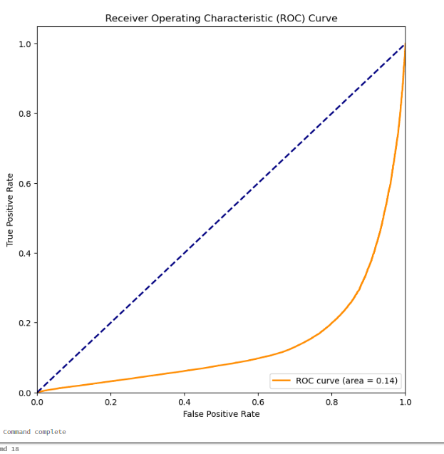
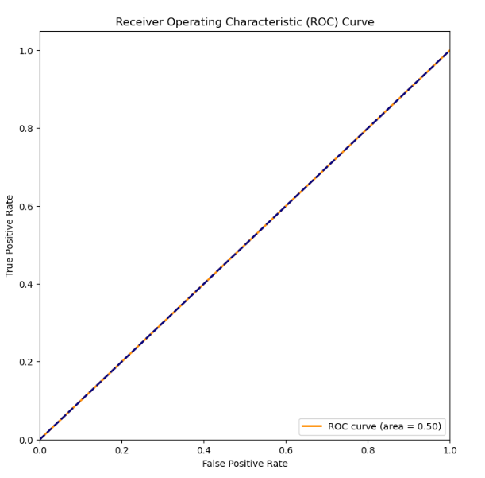
Evaluation and Results (continued)
AUC Scores from different embedding
Inference
Sentence embedding has superior AUC-ROC compared to GloVe(Word) embedding
The AUC-ROC score in word embedding is 50% and equivalent random guessing and hence not acceptable
One of the reasons of this unacceptable AUC in word embedding is the models inability to predict the insincere question as mentioned in previous slide
Should we display this, is it not showing a very bad AUC ? Is it really showing 79% ?

Slide 3

Lessons Learnt, Conclusion
It is possible with a high degree of accuracy and confidence to tag a question in quora as sincere or insincere
Had to change the direction of project from the initial plan a few times including technology and approach thus increasing the effort. In future, we would like to pay additional attention to feasibility of the proposed approach with special consideration of the free tier features.
Databricks free tier provides only 8 GB heapspace – not adequate for glove embedding analysis
Amazon EMR does not provide any free tier
The dataset being highly unbalanced towards sincere questions, the model development needed extra attention and processing to make sure the train, test data had proper representation of the actual data and not extra biased to sincere questions only
We have used F1 Score as metric between the predicted and the observed targets as the dataset is highly imbalanced.
Sentence and word embedding displays similar overall F1 score and accuracy, but word embedding does not provide good performance for insincere questions (F1, Precision, recall, AUC)

Slide 4
Future Work
Though word embedding provided overall F1 score and accuracy, but it does not provide good performance for insincere questions (F1, Precision, recall, AUC). Would like to understand the root cause and refine the model further
The AUC of the sentence embedding model provides 80% score, Would like to evaluate the options to increase it.
Applying of different text models like Random forest, SVM, and may be ensemble features to evaluate the best model
Apply the model and techniques to a different dataset like longer statements and declarative statements other than questions

